Slide 1
ATLIQ HARDWARE
SALES ANALYTICS: EXCEL

Slide 2
Atliq Hardware Business Model
Atliq is a company that sells hardware to different stores(customer) and then these stores sell those hardwares to customers (Consumers).
Atliq sells hardware to 2 kind of platforms : Brick & Mortar and Ecommerce.
There are 3 channels that is followed by Atliq
Direct
Retailer
Distributer.

Slide 3
Problem Statement
Make reports using the Atliq Data.
Sales Analytics : Create a report containing Customer performance and Market vs Target Performance.
Finance Analytics : Create a Profit and Loss report of Atliq hardware.

Slide 4
Tech Sack Used : Excel
ETL (Extract Transform Load)
ELT (Extract Load Transform)
Power Pivot
Data Modelling
Power Query

Slide 5
Sales Analytics

Slide 6
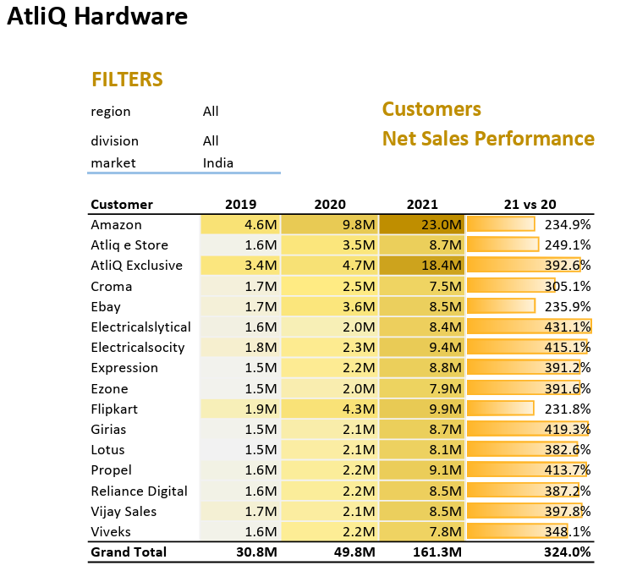
customer net sales performance report

Slide 7
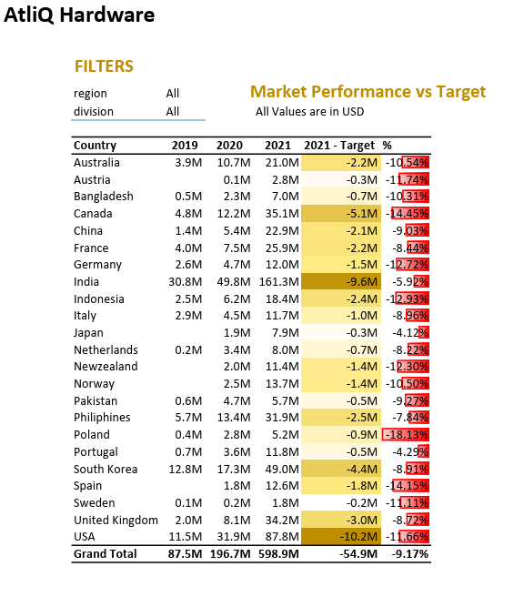
Market Vs Target performance

Slide 8
Finance Analytics
Profit and Loss Reports

Slide 9
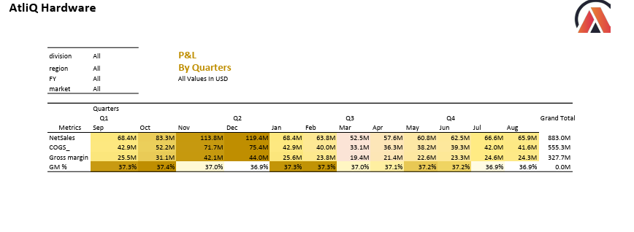
Profit and Loss by Months and Quarters

Slide 10
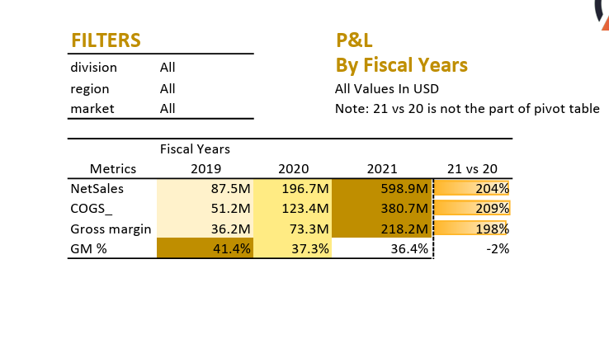
Profit and Loss Report by Fiscal Years

Slide 11
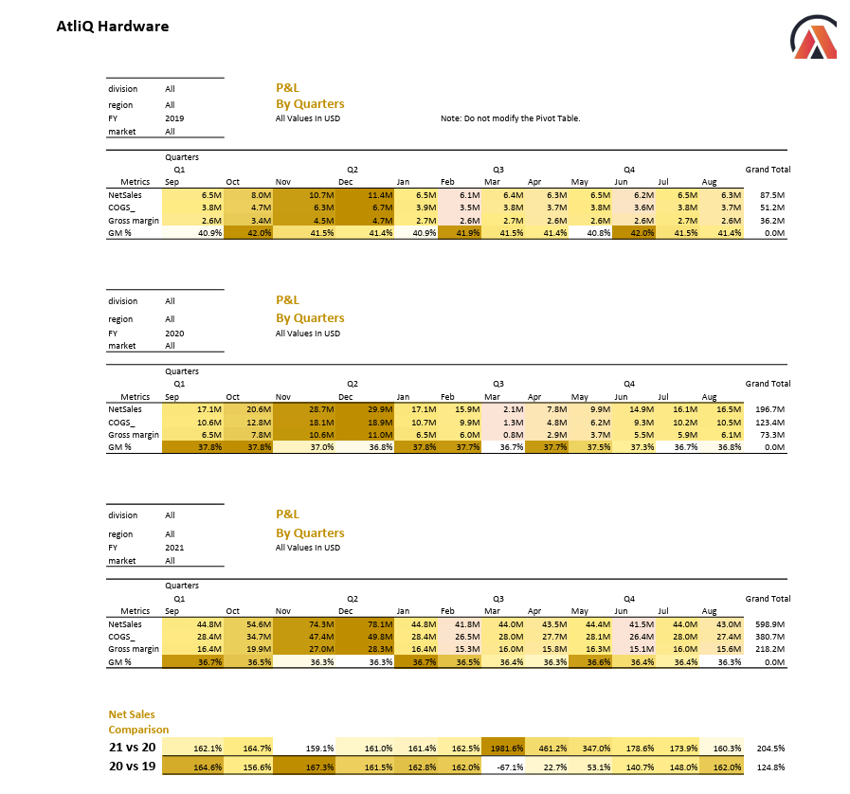
Profit and Loss Report By All

Slide 12
Thank you

